Slide 1





The Solutions services:

Slide 2
Solutions For Men:
Solutions For Men provides:
Services designed to cater specifically for the issues and experiences faced by men
Freedom from the ‘tyranny of distance’, allowing access beyond normal geographical limits
Practitioners accredited by the Australian Institute of Male Health and Studies, ensuring a high quality of service

Slide 3
Solutions For Young Men:
Solutions For Young Men provides:
Services designed specifically with the issues faced by young men in mind
A way to use the service from many different locations, delivered over broadband
The ability to get help without fees or charges in most cases, especially if you’re under 18 or receive youth or student allowance

Slide 4
Solutions For Staffing:
Solutions For Staffing uses online video-conferencing to provide:
Experienced casual contract Psychologists, Psychotherapists, Mental health practitioners, and Mentors (for young males)
A First Contact Team service to negotiate appointments with clients
Support, training, and supervision for your practitioners and counsellors

Slide 5
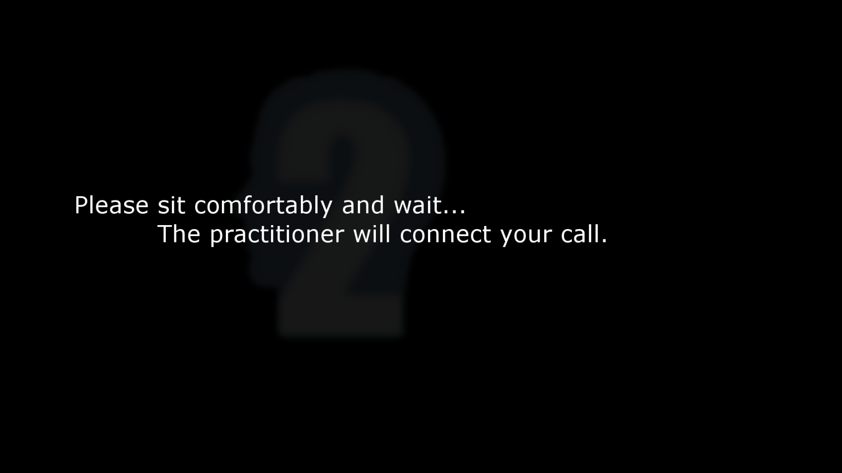



How does a session work?

Slide 6

How does a session work?

Slide 7

How does a session work?

Slide 8
Solutions For Education:
Solutions For Education provides:
Virtual classrooms designed to accommodate group video chat, text chat, PowerPoint presentations, virtual whiteboard and more
A system suited students and professionals seeking information sessions, small seminars, further learning and group-briefings
Integration with Moodle, providing class recordings as a resource

Slide 9
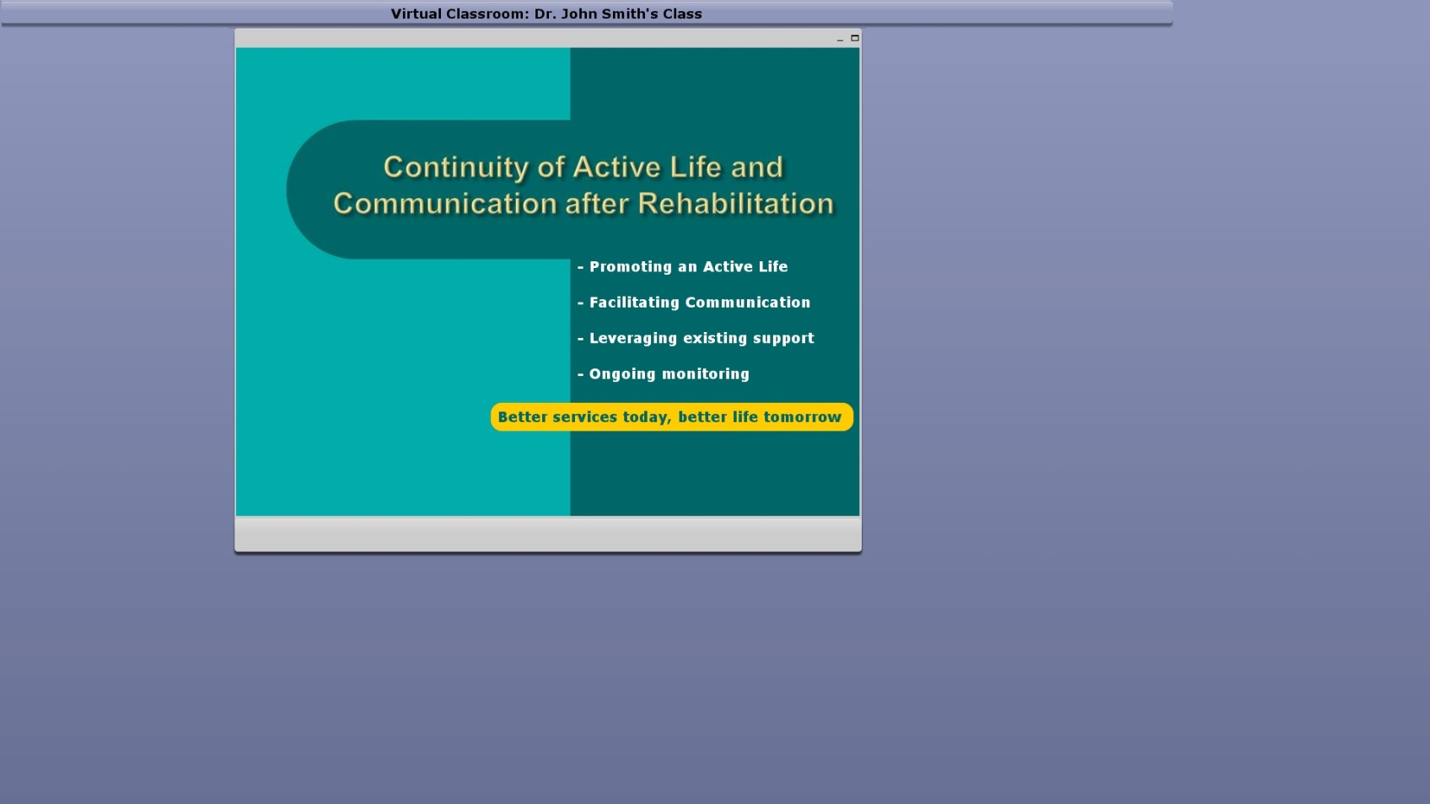

How does a classroom work?

Slide 10
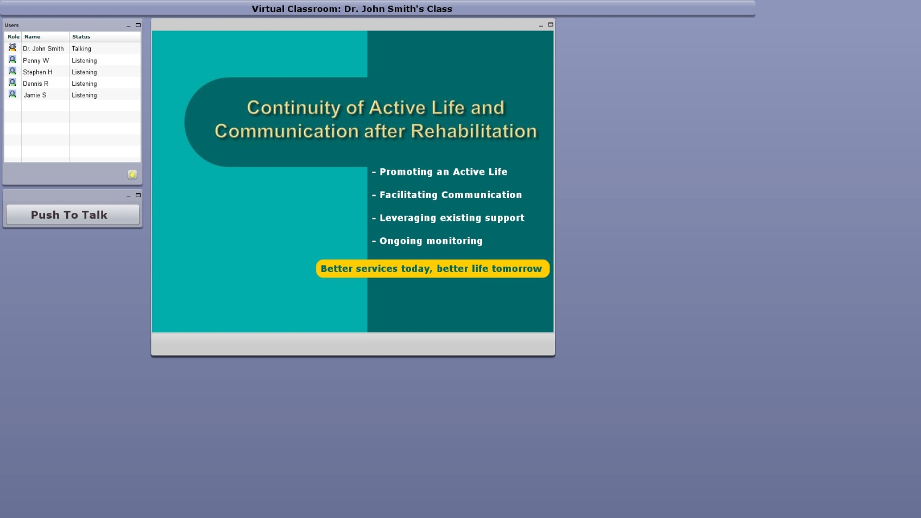
How does a classroom work?

Slide 11
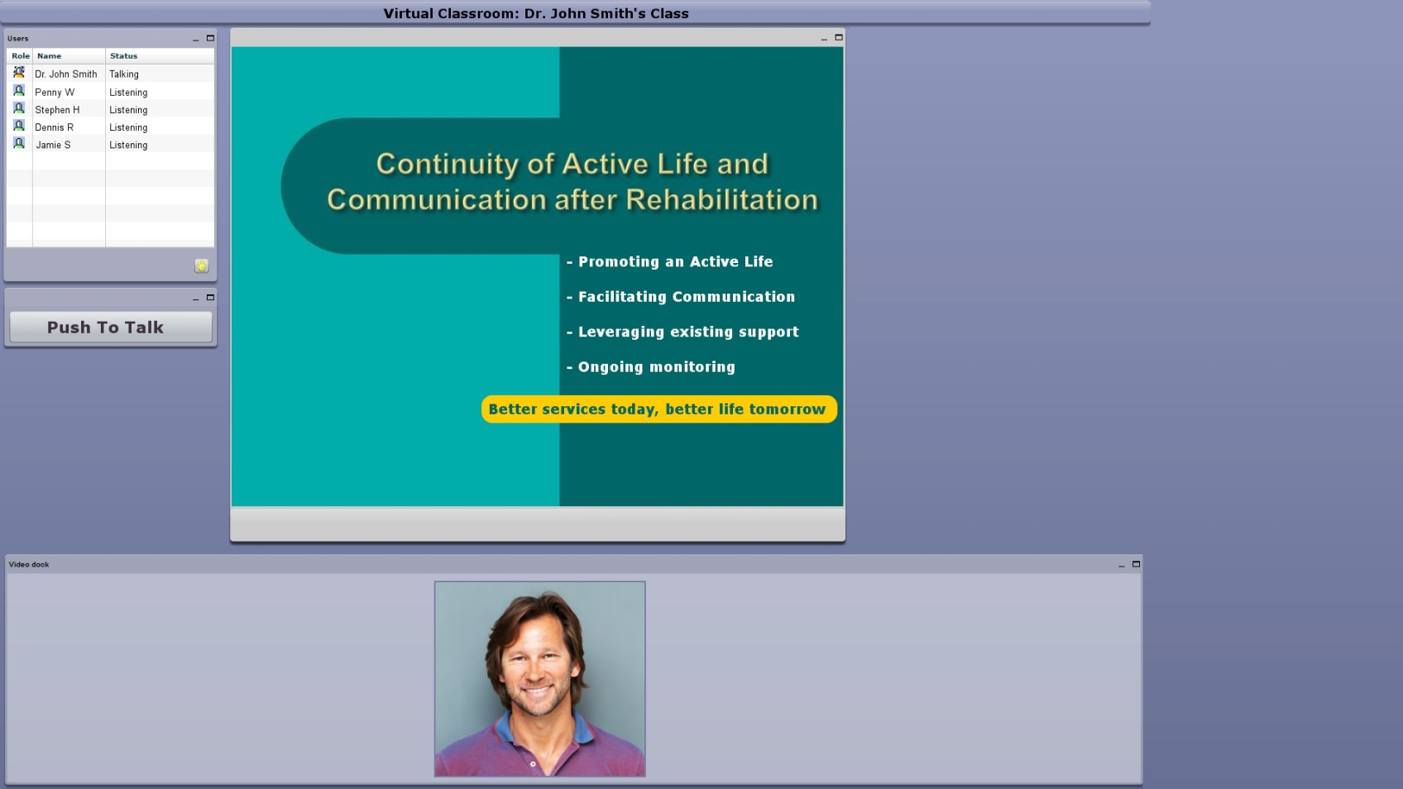
How does a classroom work?

Slide 12
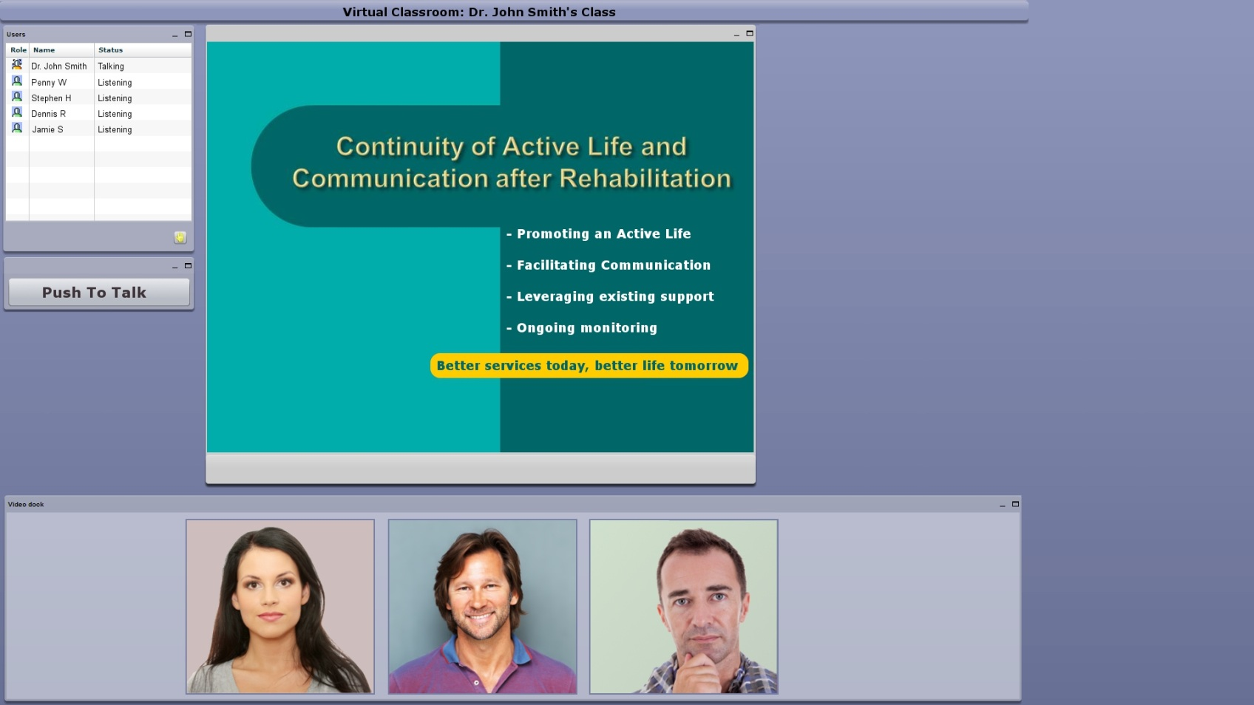
How does a classroom work?

Slide 13
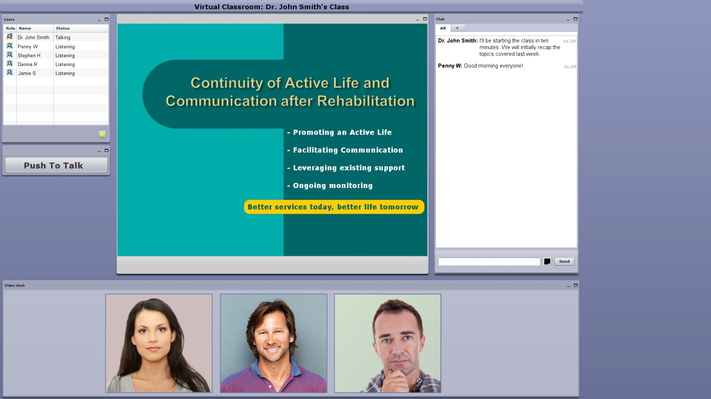
How does a classroom work?

Slide 14
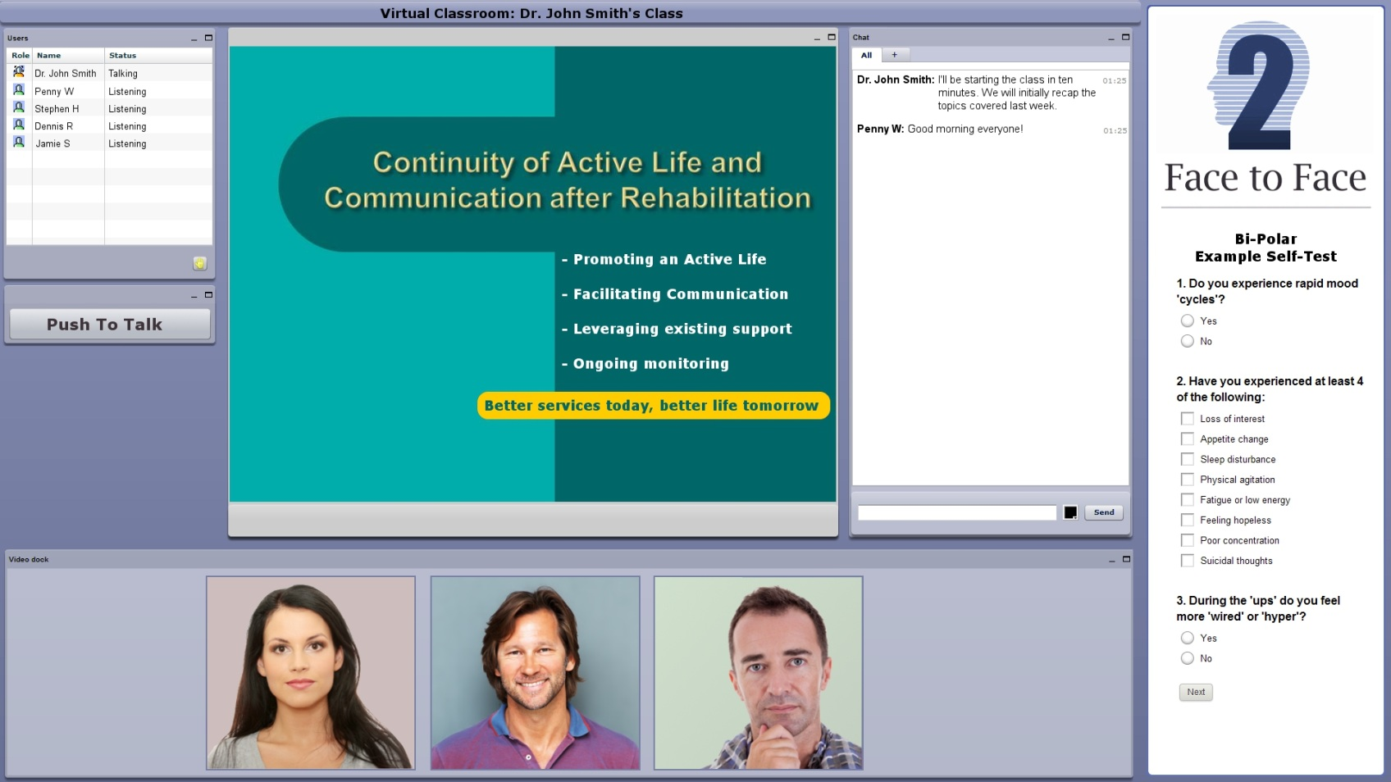
How does a classroom work?

Slide 15


